Slide 1
《Guide to Accessible Inclusion》 Accessible Inclusion Workshop Session I:Respecting Differences
Sponsored by
Labour and Welfare Bureau
Production

Slide 2
Thematic activity： same but different

Slide 3
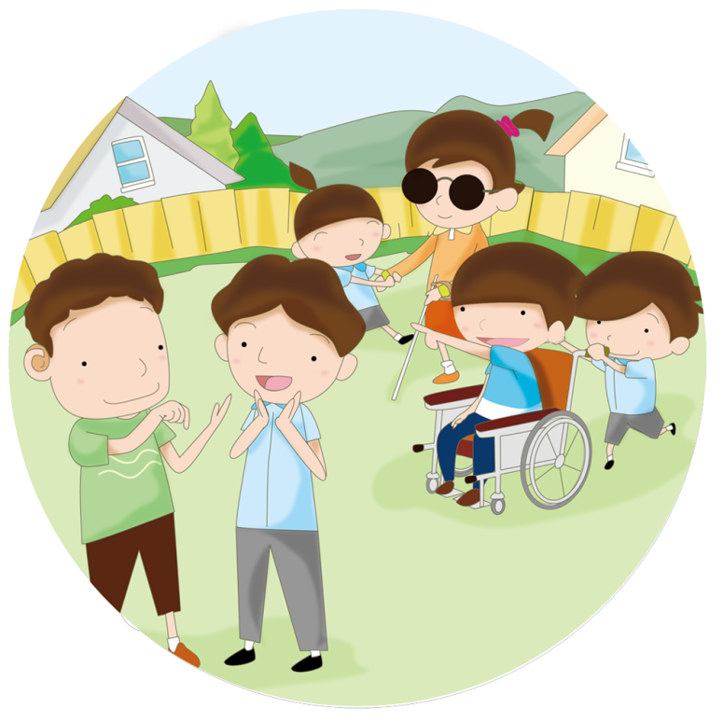
SAME BUT DIFFERENT
What do you think are the similarities among classmates? What are the differences?
Each group of students should find and share 5 similarities and differences, such as interests, family backgrounds, subject preferences, etc.

Slide 4
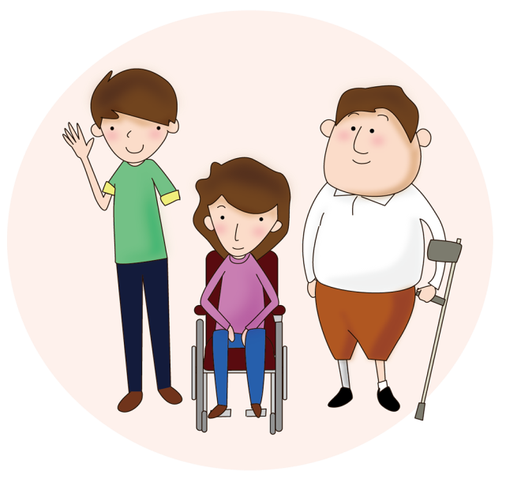
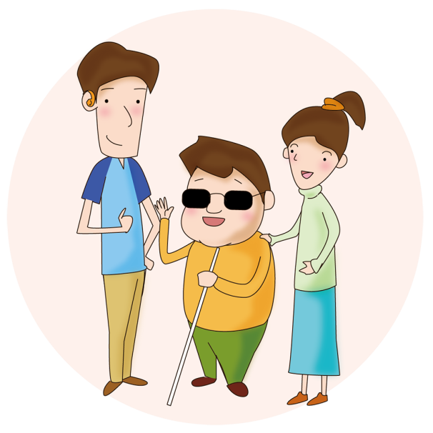
What is a “person with a disability”?
A "person with a disability" generally refers to person who loss of the bodily or mental functions that affect their daily life.
《Disability Discrimination Ordinance》

Slide 5
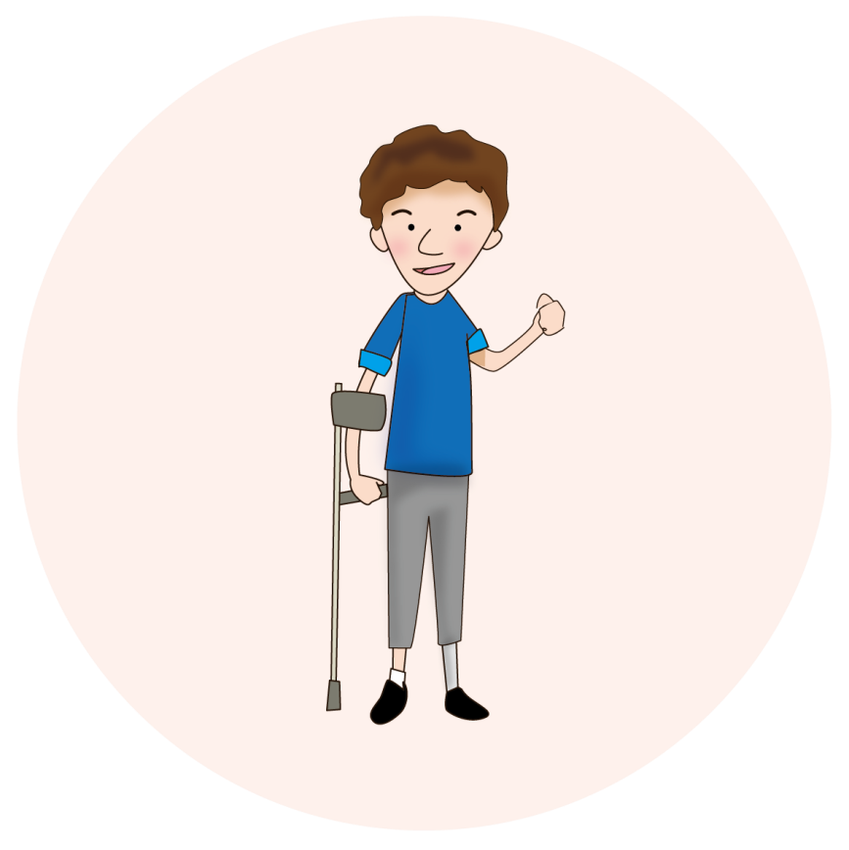
What is a “person with a disability”?
In Hong Kong, the most common types of disability are:
(1) Physical Disability
This refers to the loss or impairment of
the function of the arm or leg,
which affects daily activities.

Slide 6
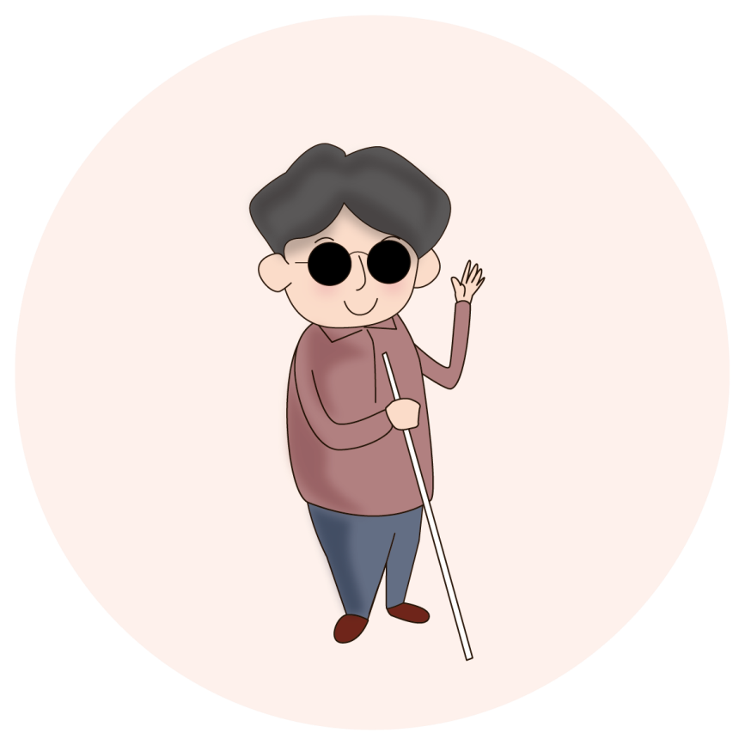
What is a “person with a disability”?
In Hong Kong, the most common types of disability are:
(2) Visual Impairment
A visual impairment that
makes it difficult or impossible
to see.

Slide 7
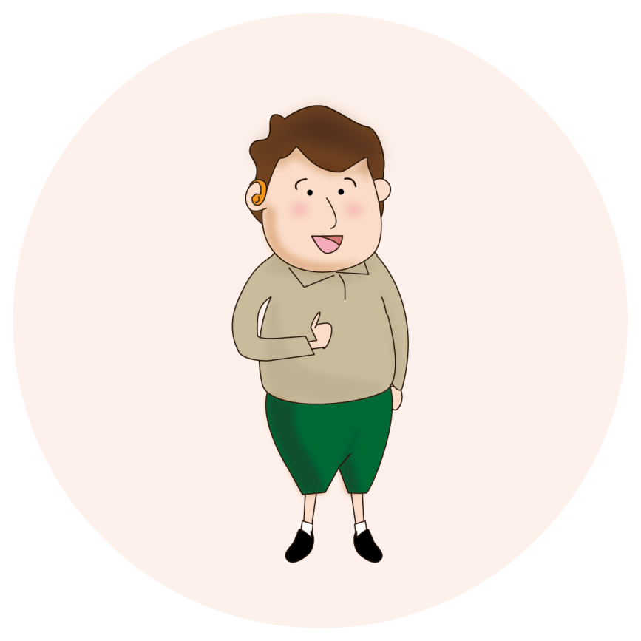
What is a “person with a disability”?
In Hong Kong, the most common types of disability are:
(3) Hearing Impairment
A hearing impairment that makes
it difficult or impossible
to hear sounds.

Slide 8
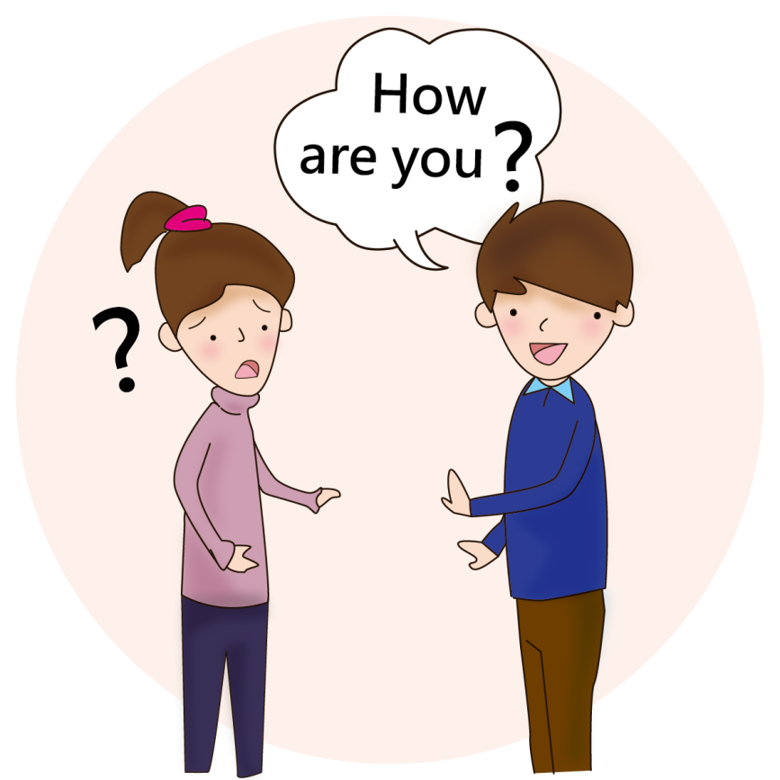
What is a “person with a disability”?
In Hong Kong, the most common types of disability are:
(4) Speech Impairment
Difficulty in speaking that affects
communication skills.

Slide 9
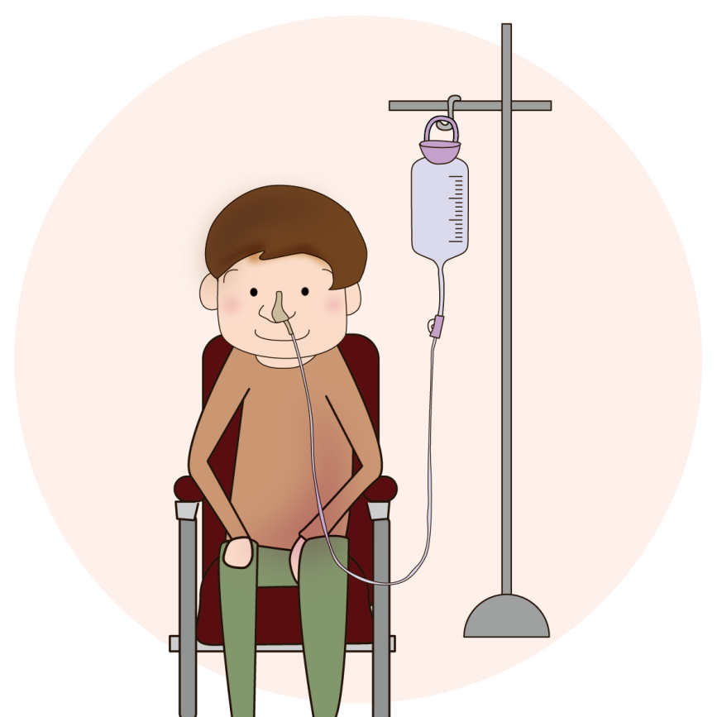
What is a “person with a disability”?
In Hong Kong, the most common types of disability are:
(5) Organic Disability/
Chronic Illness
Conditions caused by disease or treatment,
such as organ dysfunction or limitations in
daily functional mobility.

Slide 10
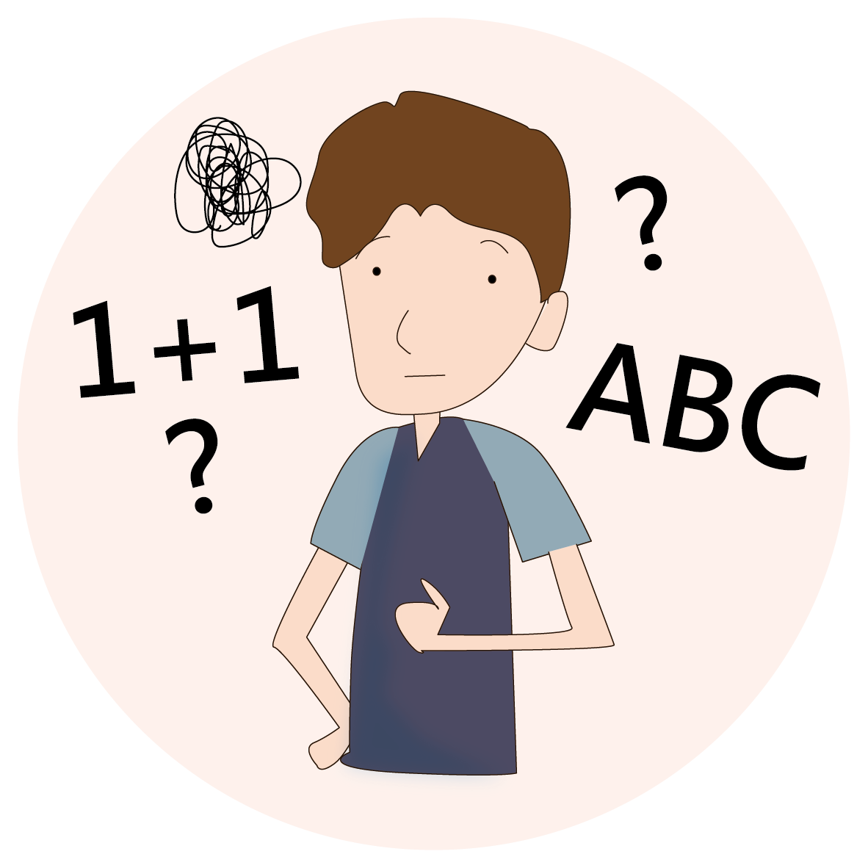
What is a “person with a disability”?
In Hong Kong, the most common types of disability are:
(6) Intellectual Disability
Below-average intelligence,
limitations in learning and
adaptability

Slide 11
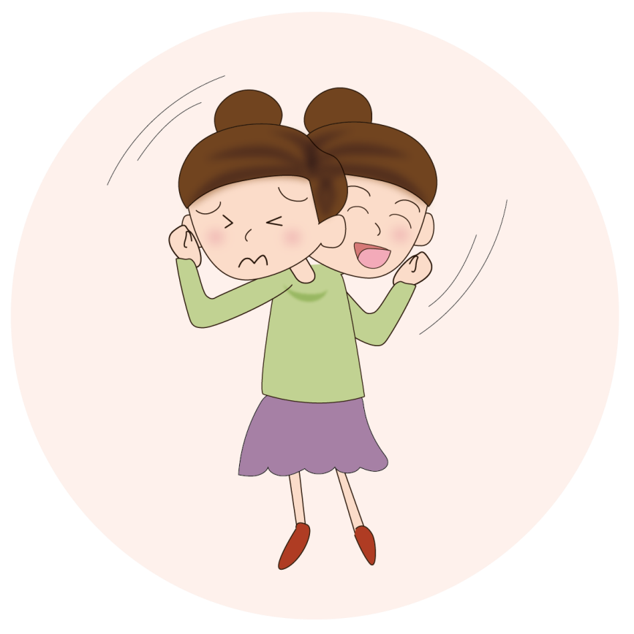
What is a “person with a disability”?
In Hong Kong, the most common types of disability are:
(7) Mental Illness
A disorder or disturbance of the
emotions, mind or behaviour.

Slide 12
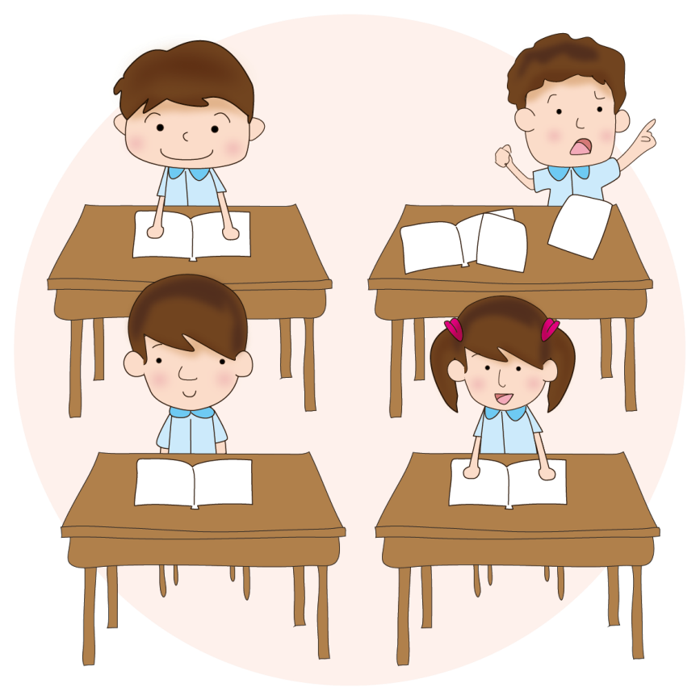
What is a “person with a disability”?
In Hong Kong, the most common types of disability are:
(8) Attention Deficit/
Hyperactivity Disorder
This refers to a person who cannot
concentrate for long periods of time,
has excessive activity and
poor self-control.

Slide 13
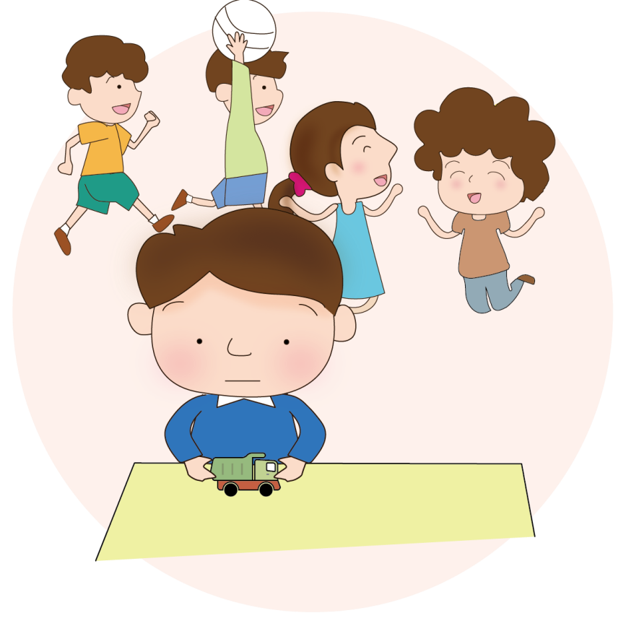
What is a “person with a disability”?
In Hong Kong, the most common types of disability are:
(9) Autism
Social and communication barriers.

Slide 14
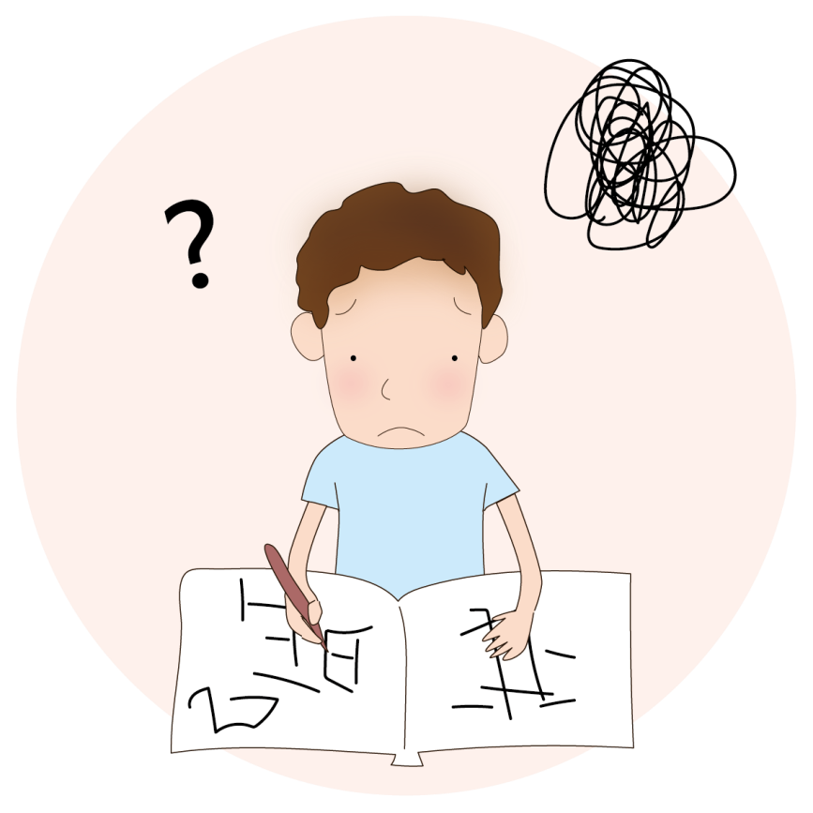
What is a “person with a disability”?
In Hong Kong, the most common types of disability are:
(10) Specific Learning Difficulties
Abnormalities in learning performance,
e.g. dyslexia, etc.

Slide 15
“Let us value each other and work together
to create a more inclusive and better society.”

Slide 16
Experiential activity： leg immobiliser

Slide 17
LEG IMMOBILISER
Students will simulate completing designated tasks with limited leg mobility.
2. During the process, please feel the impact of restricted physical activity on daily life.

Slide 18
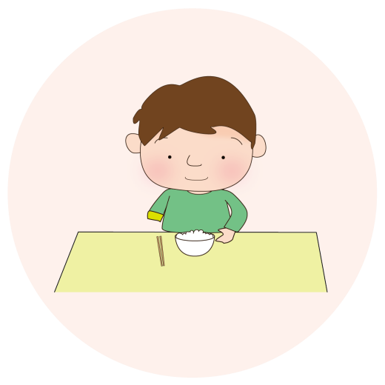
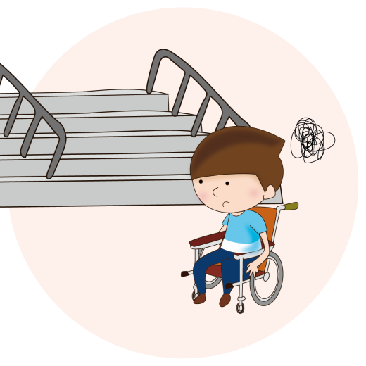
People with Physical Disabilities
1. People with physical disabilities are those with missing or impaired arms or legs, which limits their ability to move their legs or arms, making it difficult for them to get around or affecting their daily lives.
2. Some people with physical disabilities need to use walking canes, wheelchairs or electric wheelchairs to help them walk, and it would be very inconvenient for them to get around if there were no accessible facilities such as ramps or lifts in the community.

Slide 19
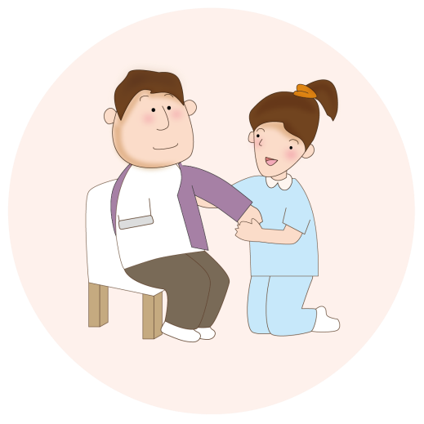
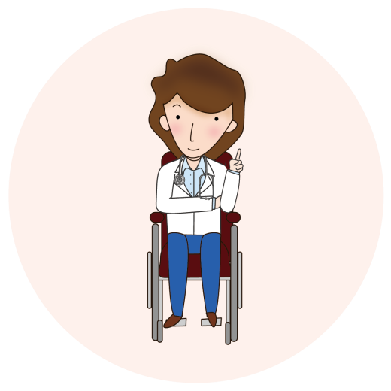
People with Physical Disabilities
3. For people with severe physical disabilities (e.g. quadriplegics), their ability to care for themselves is also affected, and they are more likely to need help with bathing and dressing.
4. Although people with physical disabilities face many difficulties and challenges in their lives, there are many people with physical disabilities in our society who have overcome physical challenges and achieved outstanding results.

Slide 20
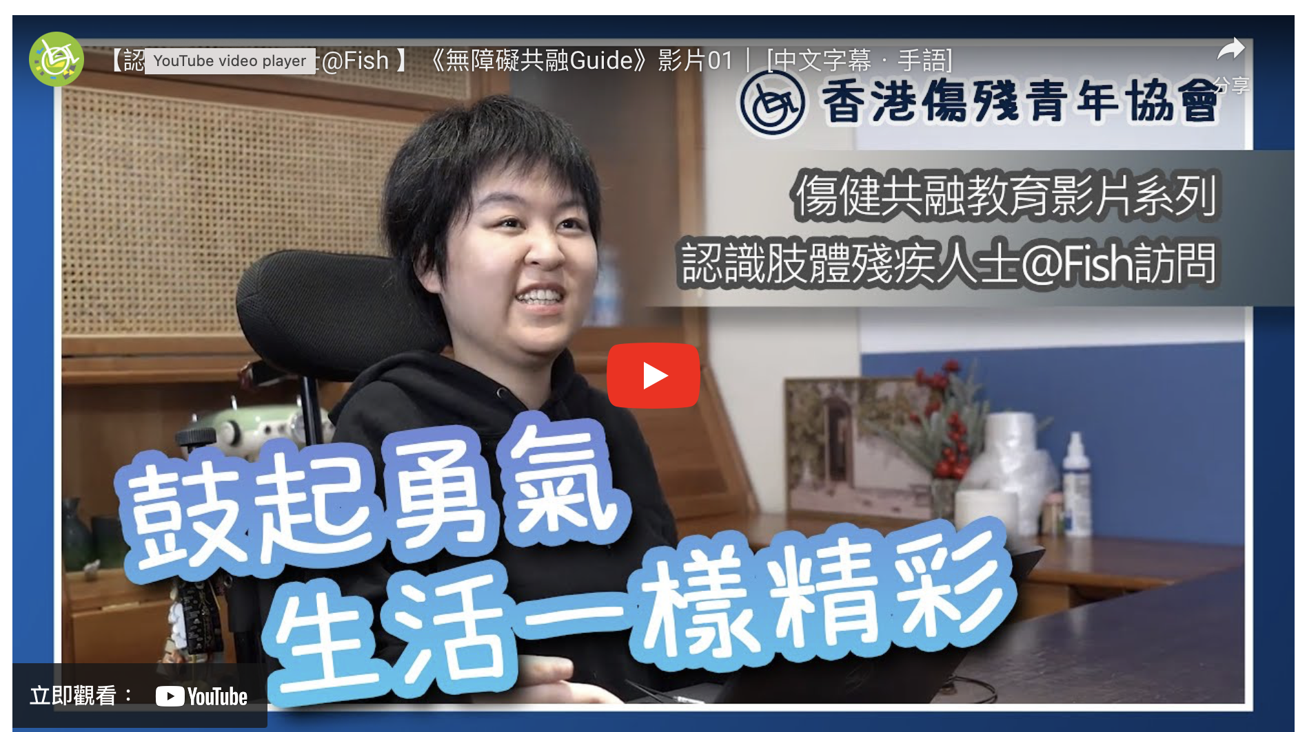
Learn more about People with Physical Disabilities @Fish
https://youtu.be/rgjQaUewlOc?feature=shared

Slide 21
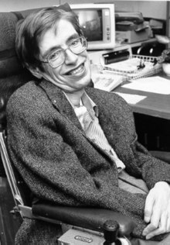
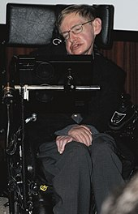
Stephen Hawking (1942-2018)
As a young man, Hawking showed remarkable academic talent, and was consistently at the top of his class during his time at the University of Oxford.
Unfortunately, at the age of 21, Hawking was diagnosed with Muscular Atrophic Lateral Sclerosis (MALS), which caused him to gradually lose control of his body.

Slide 22
Stephen Hawking (1942-2018)
His muscle wasting worsened and he eventually lost the ability to speak, relying only on his fingers to express his thoughts and communicate with others. However, Hawking didn't give up on himself. Even though his body was deteriorating every day, his mind continued to race. Although he was physically handicapped, this did not hinder his scientific research. He produced many important ideas and theories on the study of black holes and became one of the world’s greatest physicists.
Stephen Hawking is always optimistic about his condition. His experience teaches us that as long as we persevere and don't give up, we can eventually achieve our dreams.

Slide 23
THEMATIC ACTIVITY： “who goes first for priority seats?”

Slide 24
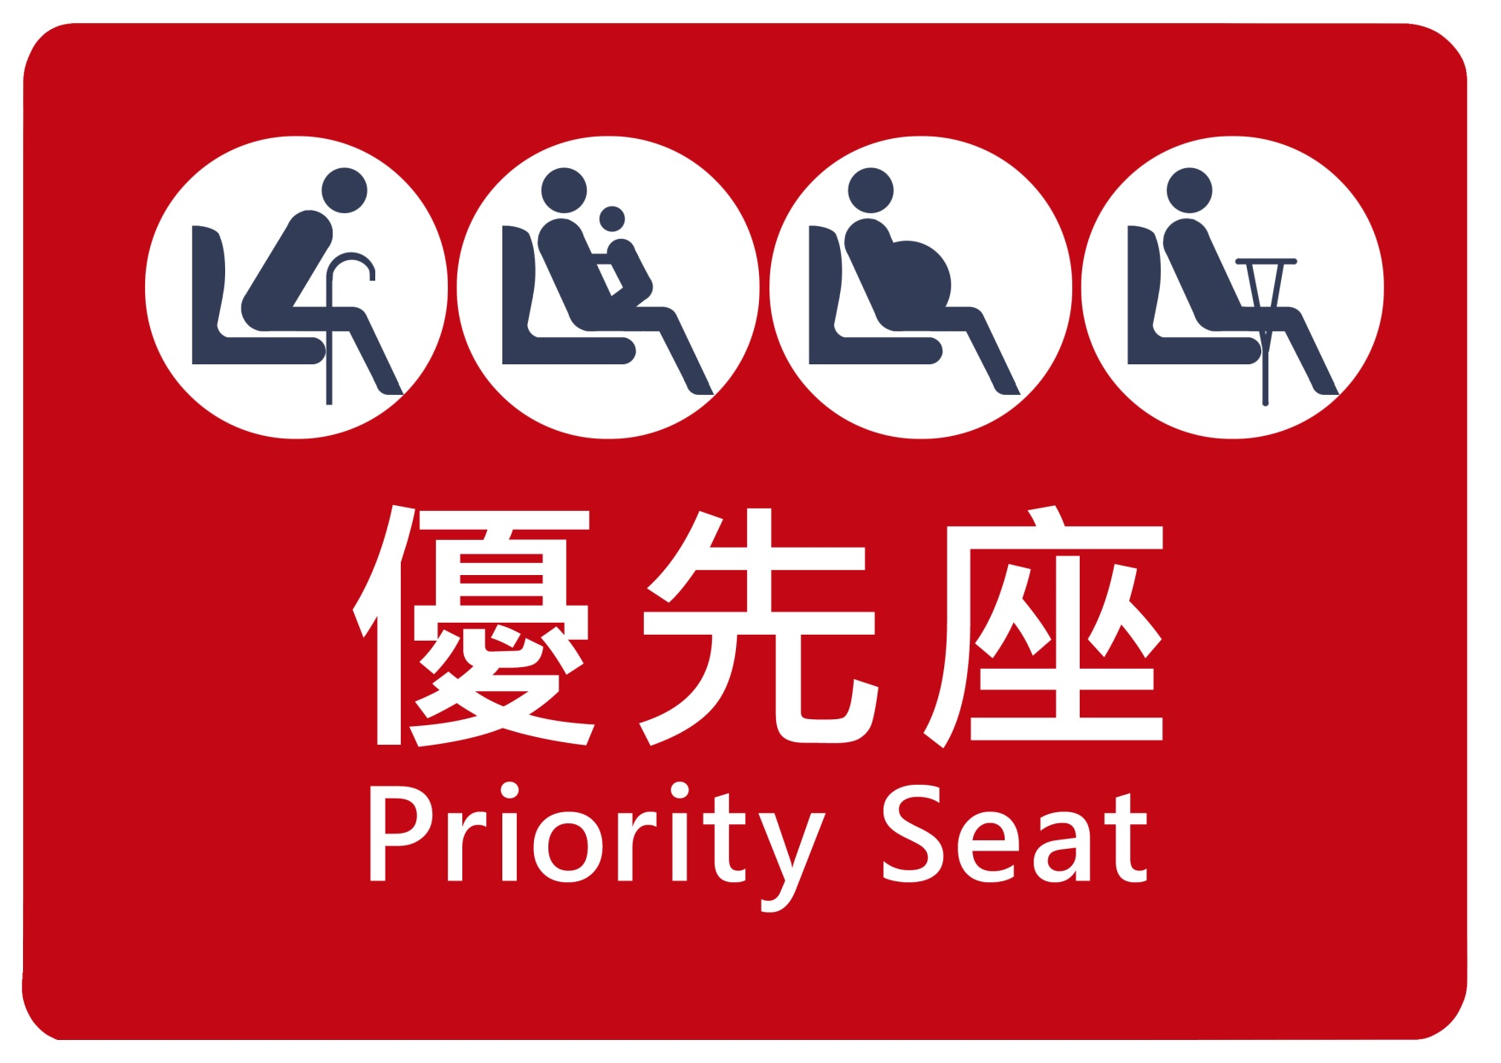
Which group should use the priority seats first?

Slide 25
CONCLUSION
In this lesson, we learned:
Different categories of people with disabilities.
The needs of people with physical disabilities.
Everyone is unique, and we should understand and respect each other.
To actively offer help when we see someone in need.

